Slide 1


DEPARTMENT OF COMPUTER ENGINEERING
Chef Transformer
Student Name : Anushree Salunke Moodle Id : 20102179 Div : C
Student Name : Eisha Saini Moodle Id : 20102025 Div : C
Student Name : Pooja Tumma Moodle Id : 20102126 Div : C
Student Name : Sanskruti Shinde Moodle Id : 21202018 Div : C
Under the guidance of Prof. Deepak K. Sir

Slide 2
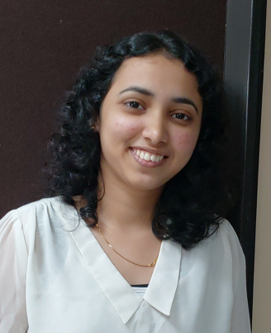
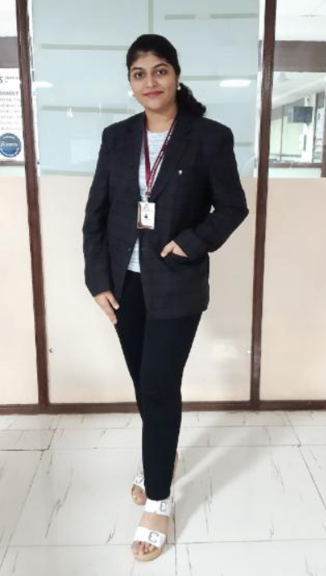
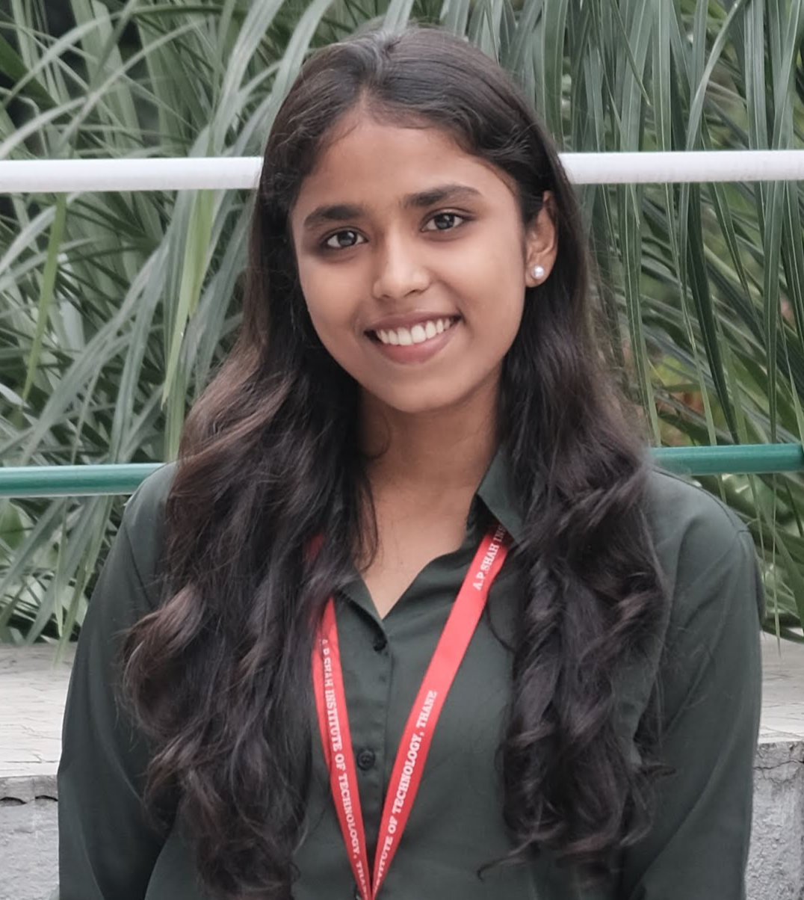
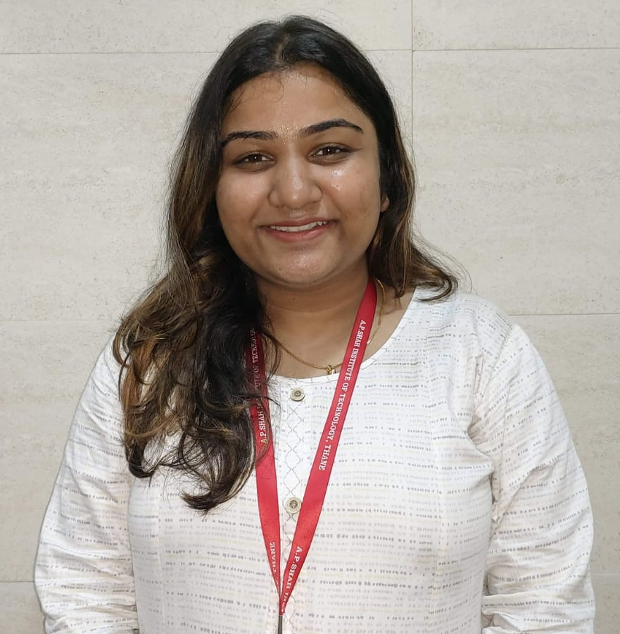
Our Team
Eisha Saini
Roll No : 15
Anushree Salunke
Roll No : 19
Pooja Tumma
Roll No : 56
Sanskruti Shinde
Roll No : 48
Chef Transformer

Slide 3
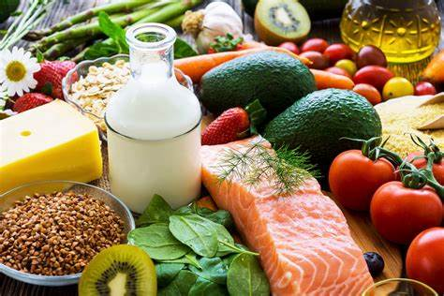
PROBLEM STATEMENT
Our project is intended to address the issue that arises when attempting to prepare a specific recipe but running out of some ingredients. To solve this issue, we have developed a web application called Chef Transformer that will offer recipes based on the ingredients that are readily available as well as a number of other features.

Slide 4
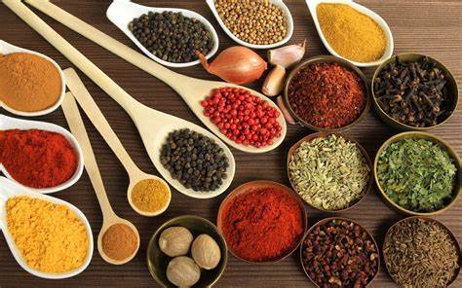
objectives
1 . To present users with either pre-existing recipes or innovative dishes based on the ingredients they have specified.
2. To come up with recipes that include both major and minor ingredients
3. It may possibly happen that a user may find trouble to spell the ingredients so our web app will recommend the ingredients based on the characters given as input.
4. Based on ingredients our app will generate the name of the dish, the quantity of the ingredients required for the dish and the step by step procedure of making that dish.
5. Based on the recipe generated an downloadable image of that particular recipe will get generated for the user

Slide 5


scope
1) Taking Ingredients as an input from the user and considering some minor ingredients if not specified.
2) Recommendation of ingredients based on the data of available ingredients
3) Generation of the recipes based on major and minor ingredients
4) Image generation of the recipe generated which can be downloaded

Slide 6
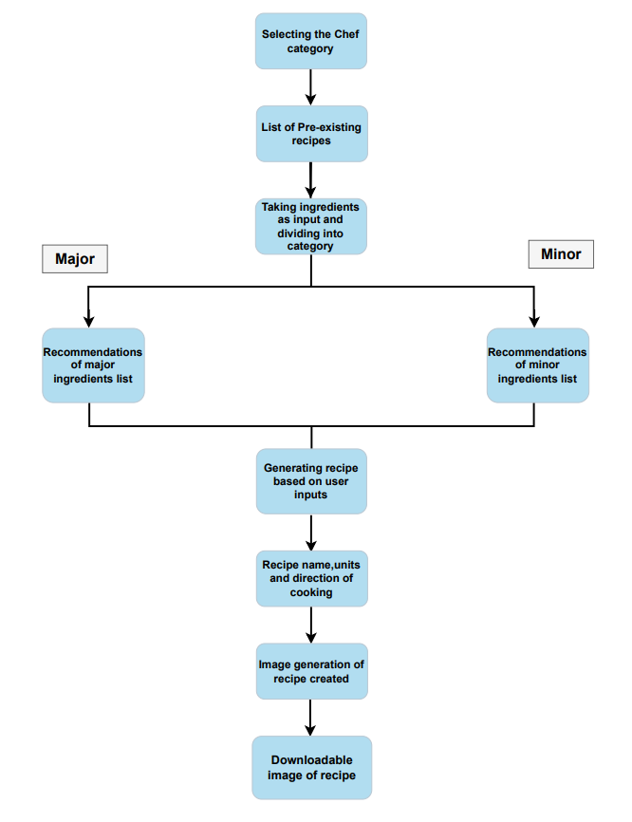
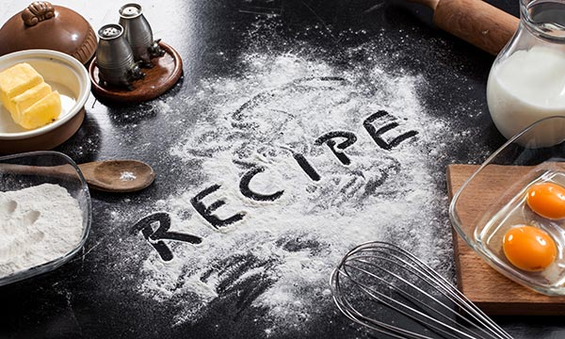
Flow Chart
.

Slide 7
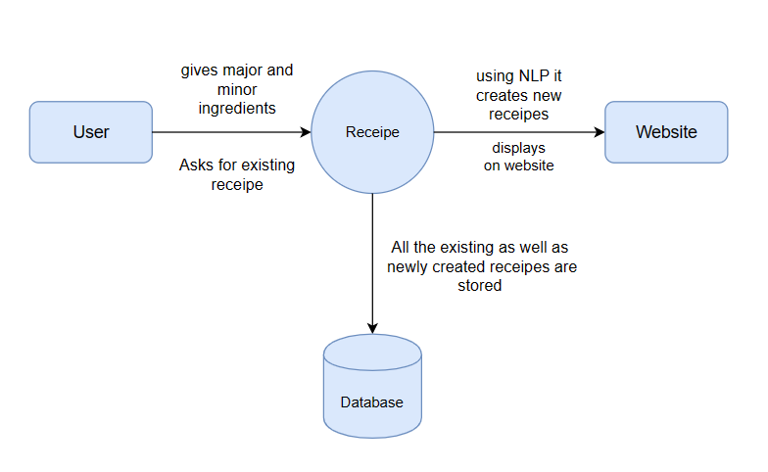
UMl Diagram: Data Flow Diagram
LEVEL 0
.

Slide 8
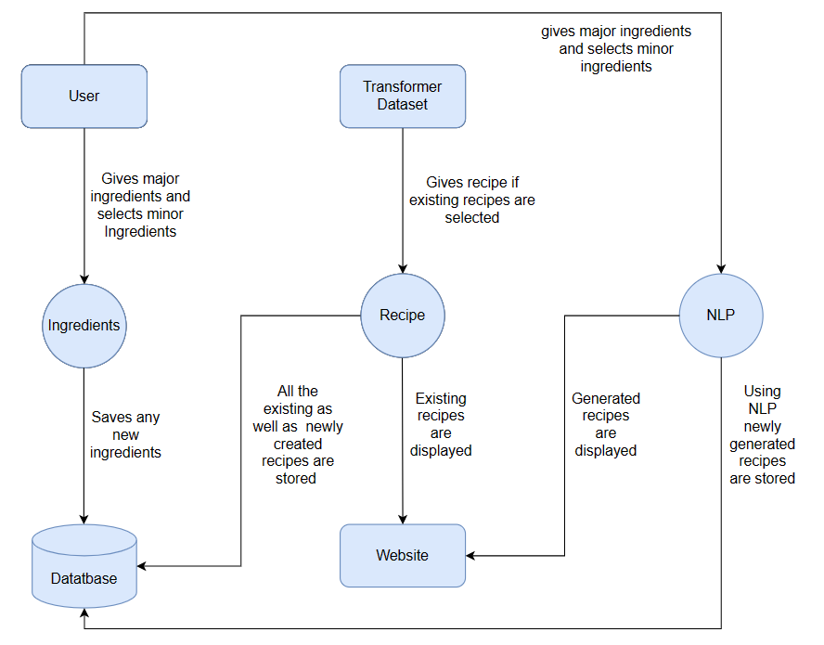
UMl Diagram: Data Flow Diagram
.
LEVEL 1

Slide 9
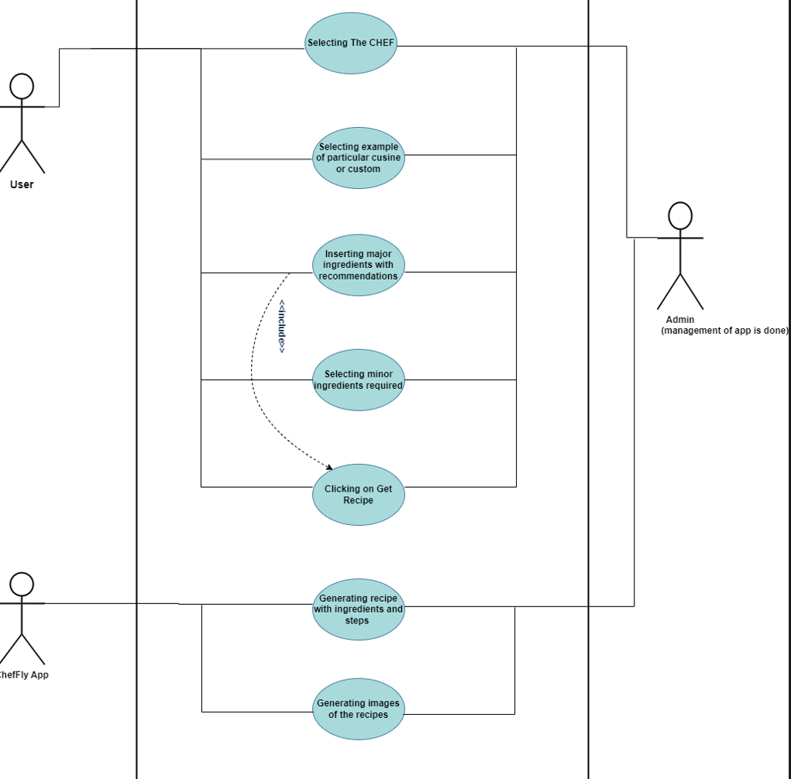
UMl Diagram: Use Case
.

Slide 10
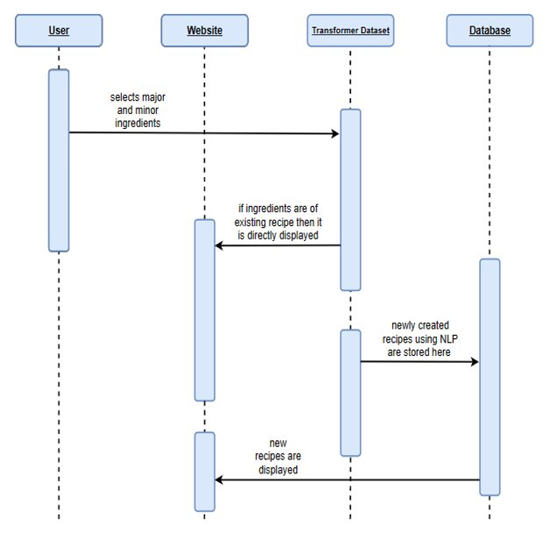
UMl Diagram: Sequence
.

Slide 11

MODULES
1. NLP - Natural Language Processing
2. ML using Transformer module
3. Major Ingredients Recommendation
4. Minor Ingredients Selection
5. Recipe Generation
6. Image generation

Slide 12


TECHNOLOGY STACK
Frontend : HTML, CSS, JS
Backend: Python
For ML model training transformers module
For NLP and text processing nltk

Slide 13
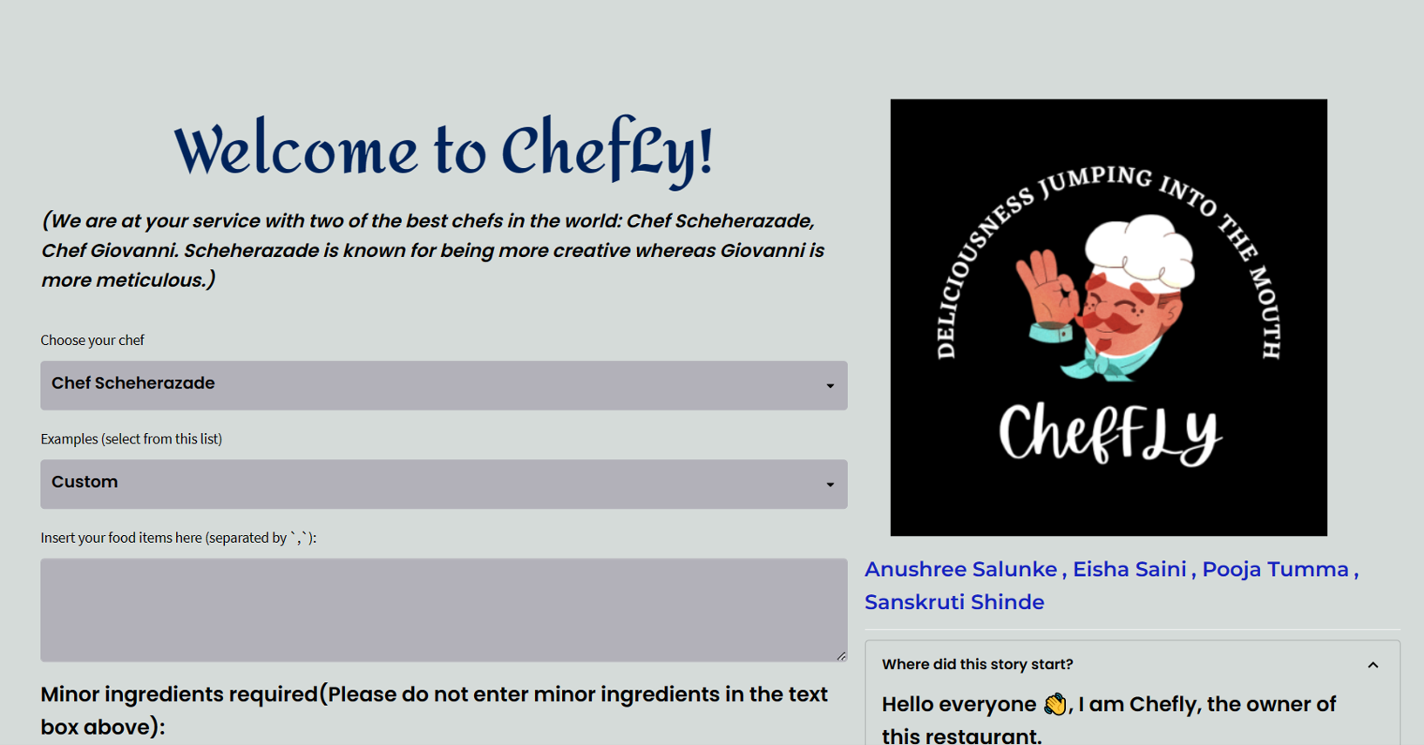
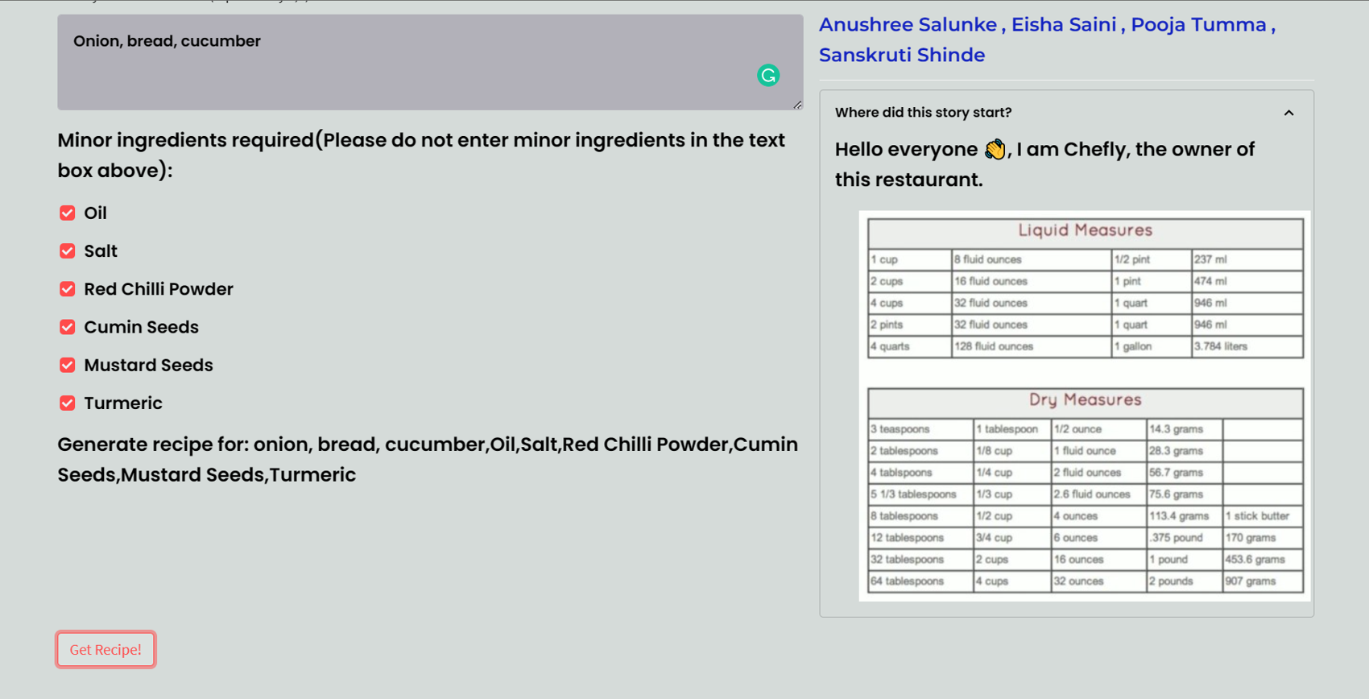
INTERFACES

Slide 14
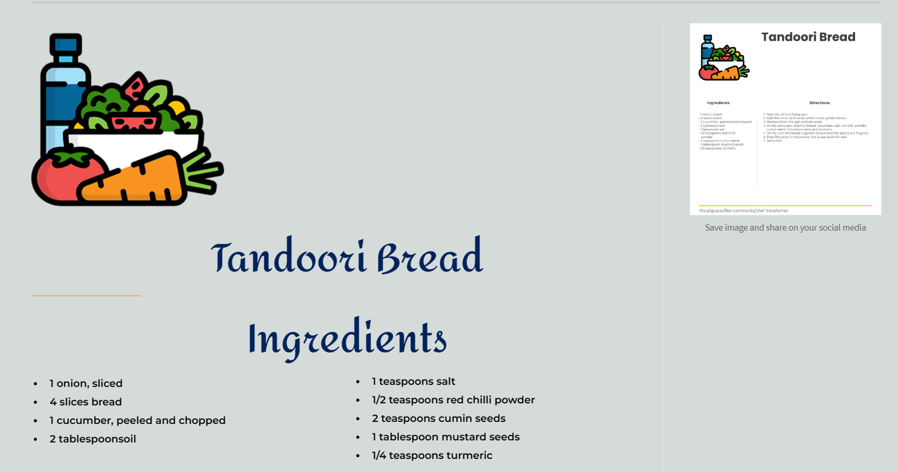
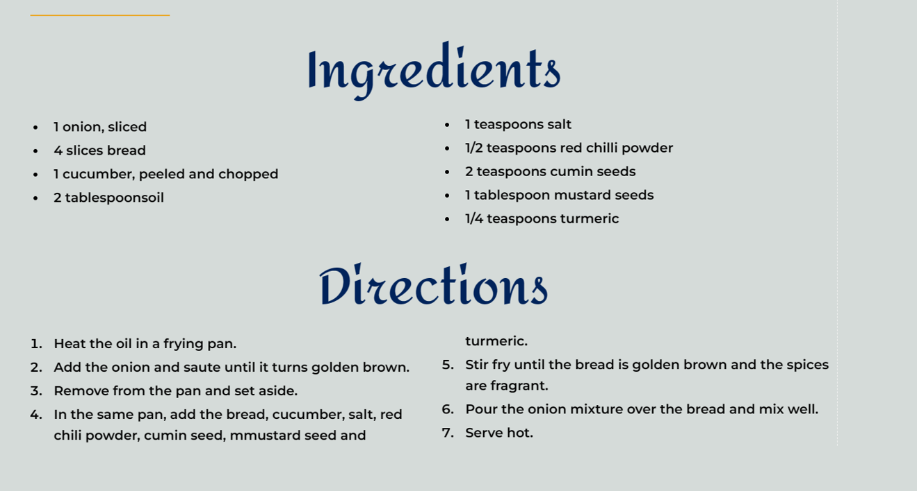
INTERFACES

Slide 15
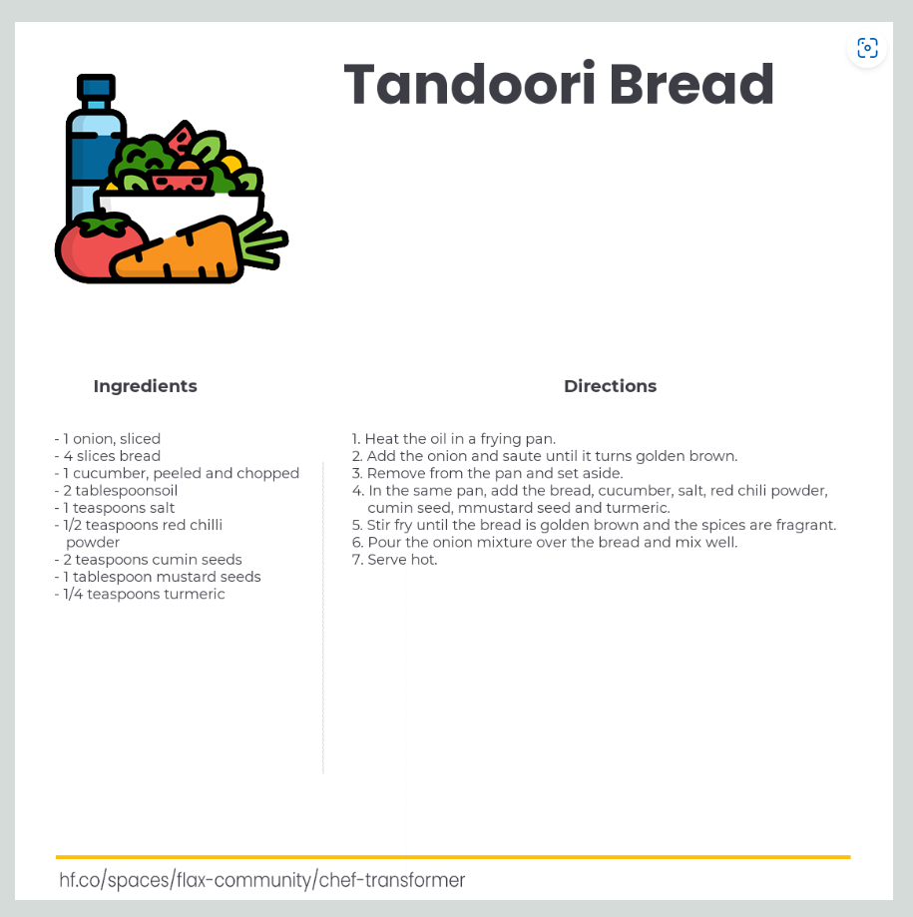
INTERFACES

Slide 16
Literature survey
Paper 1 | Application | Link
Recipe recommendation using ingredient networks | Used for recipe recommendation | https://dl.acm.org/doi/10.1145/2380718.2380757
Food Recipe Alternation and Generation with Natural Language Processing Techniques | Used for natural language processing techniques | https://ieeexplore.ieee.org/document/9094119
User-item content awareness in matrix factorization based collaborative recommender systems | Used for recommending each active user by comparing with the preferences | https://content.iospress.com/articles/intelligent-data-analysis/ida194599
Improving text-to-image generation with object layout guidance | Used for text-to-image generation with object layout guidance | https://link.springer.com/article/10.1007/s11042-021-11038-0

Slide 17
THANK YOU

